Slide 1


Introduction to
NGS Visualization with the Integrative Genomics Viewer (IGV)

Slide 2
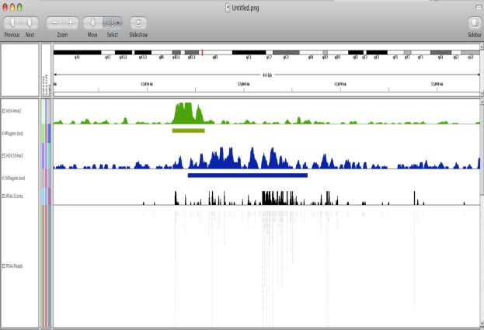
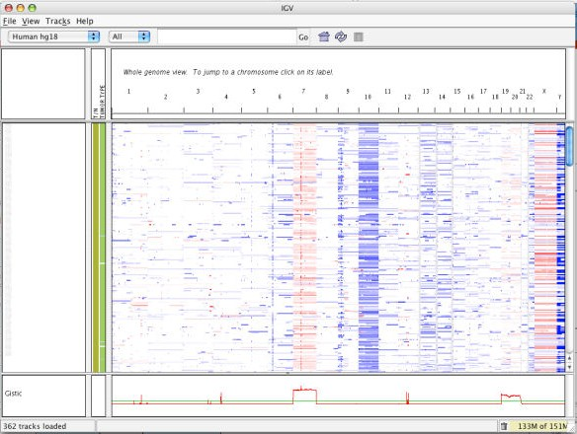
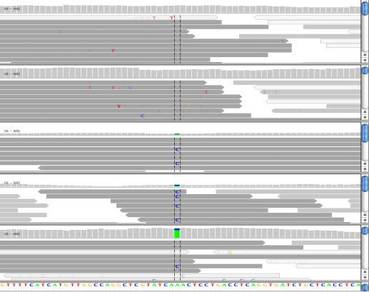
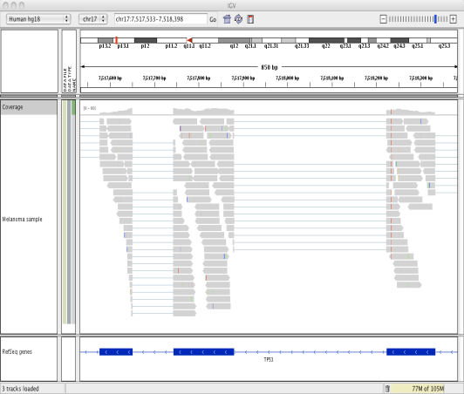
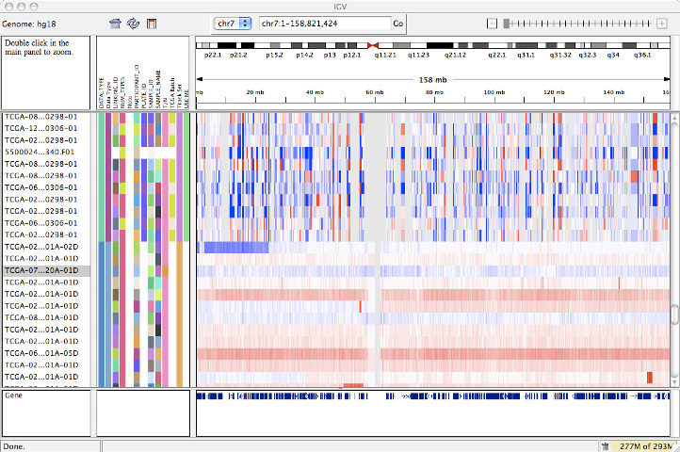
Integrative Genomics Viewer (IGV)
Desktop application for the interactive visual exploration of integrated genomic datasets
Epigenomics
Microarrays
NGS alignments
RNA‐Seq
http://www.broadinstitute.org/igv
mRNA, CNV, Seq
65,000 registrations

Slide 3
Features
With IGV you can…
Explore large genomic datasets with an intuitive, easy-to-use interface.
Integrate multiple data types with clinical and other sample information.
View data from multiple sources:
- local, remote, and “cloud-based”.

Slide 4


















IGV data sources
Local files
TCGA
GenomeSpace
HTTP server
FTP server
View local files without uploading.
View remote files without downloading the whole dataset.

Slide 5
Using IGV: The Basics

Slide 6
Using IGV: the basics
Hands-on exercise
Launch IGV
Select a reference genome
Load data
Navigate through the data

Slide 7
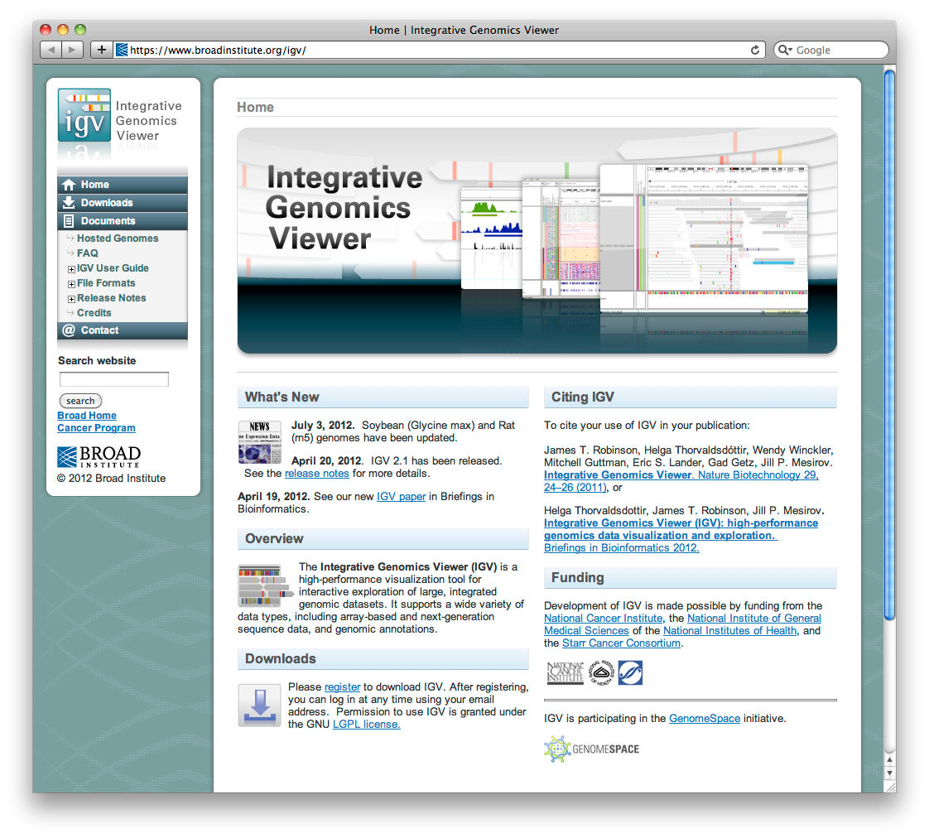


Launch IGV
http://www.broadinstitute.org/igv

Slide 8
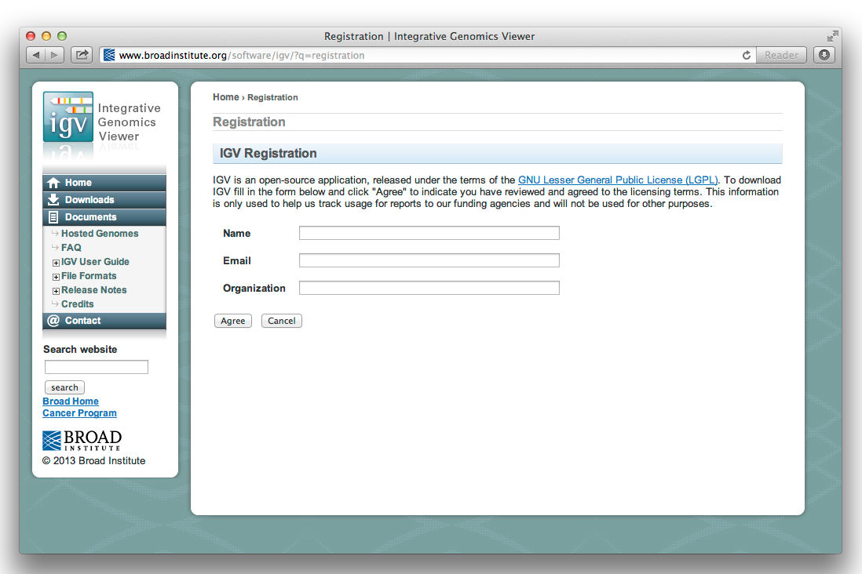
Launch IGV

Slide 9
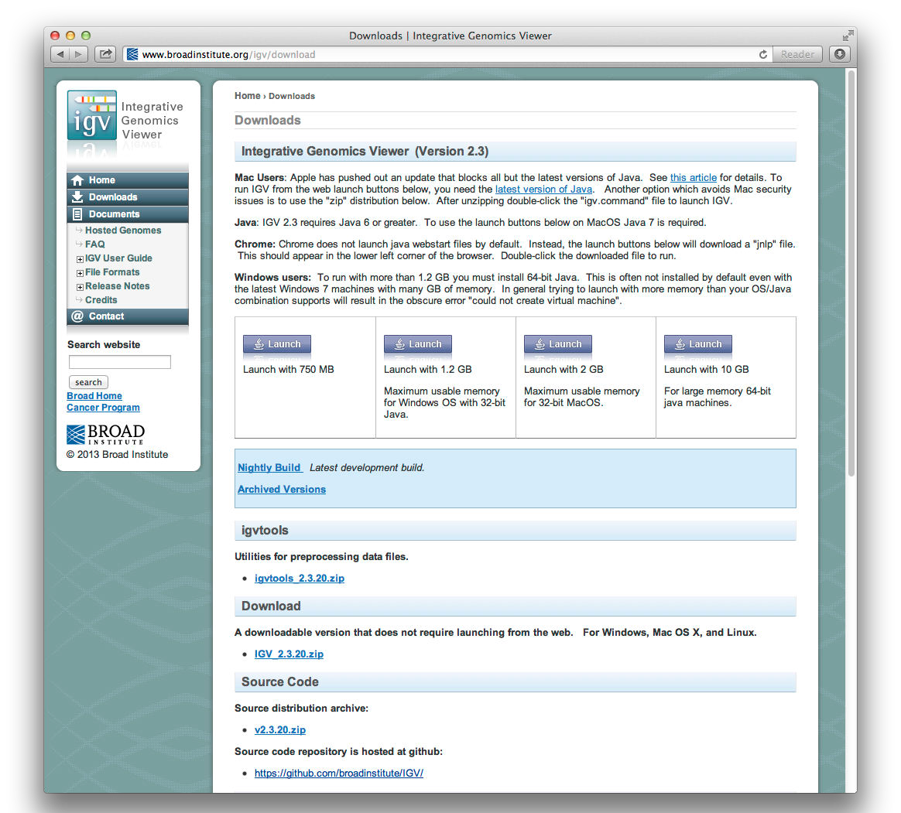


Launch IGV

Slide 10

Launch IGV

Slide 12
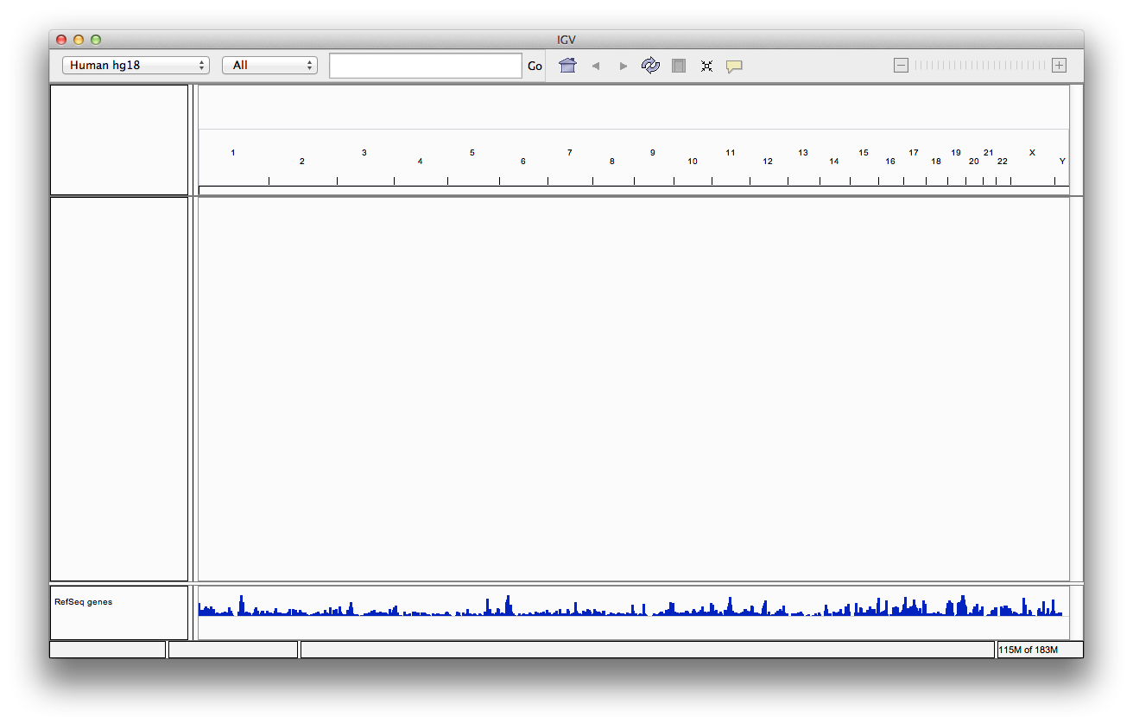
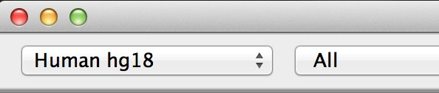
Select the reference genome
Select genome from the drop-down menu

Slide 13
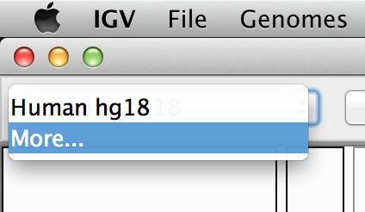

Select the reference genome
Today, we will use both
Human hg18 and hg19
If Human hg19 is not in the menu, then click on More…

Slide 14
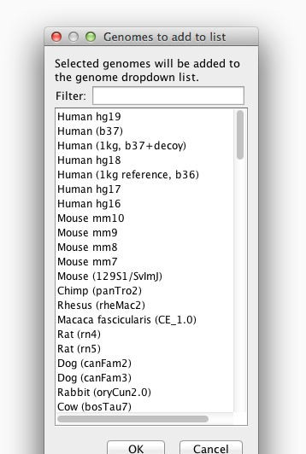


Select the reference genome
Select Human hg19 from the list of genomes, and click OK

Slide 15
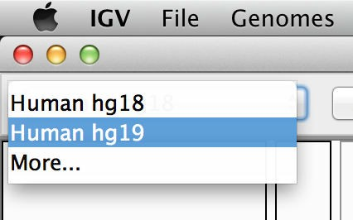

Select the reference genome

Slide 16
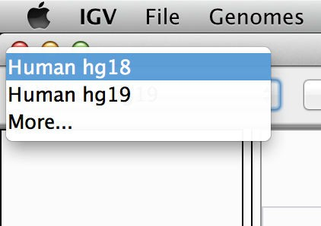

Select the reference genome
Select Human hg18

Slide 17
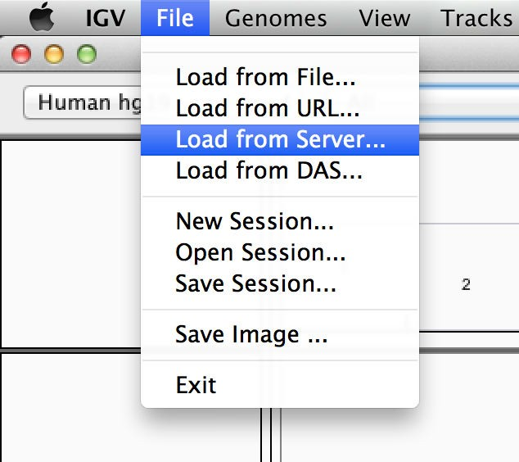

Load data
Select File > Load from Server…

Slide 18
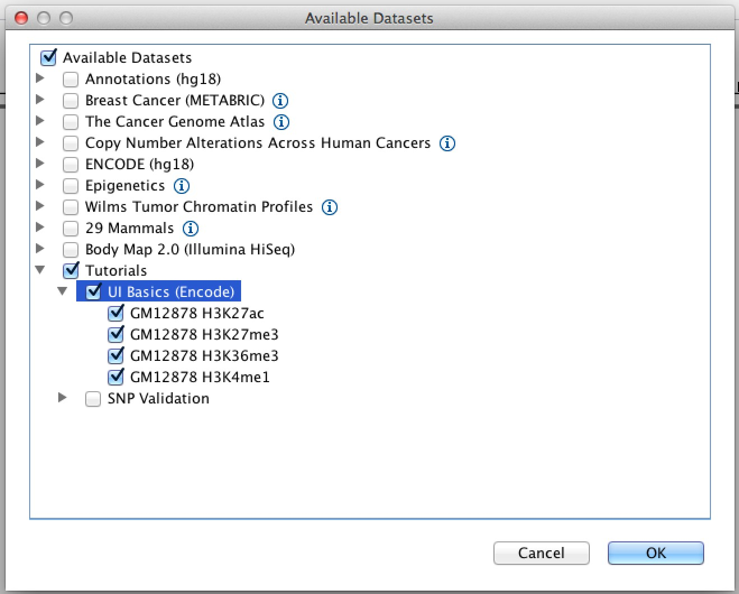



Load data
Open the
Tutorials menu
Select
UI Basics (Encode)

Slide 19
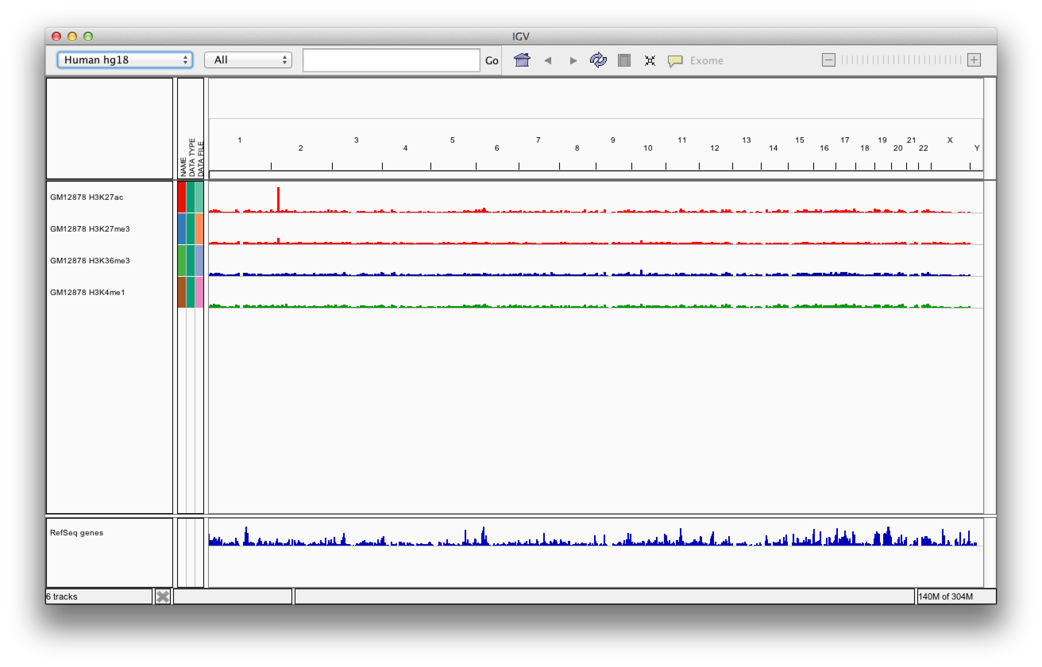
Screen layout

Slide 20
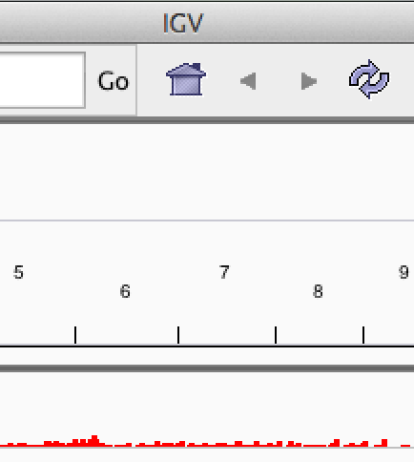

Screen layout
Click the Home button for whole-genome view

Slide 21




Screen layout
tracks

Slide 22






Screen layout
menus
toolbar
genome ruler
data panel
tracks
genome features

Slide 23
File formats and track types
The file format defines the track type.
The track type determines the display options

Slide 24
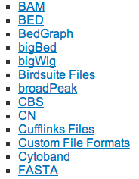
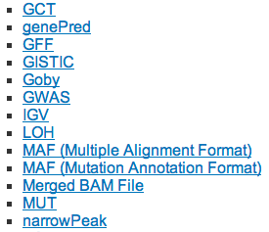
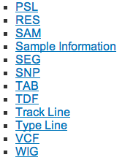
File formats and track types
The file format defines the track type.
The track type determines the display options
IGV supports many different file formats.
For current list see: www.broadinstitute.org/igv/FileFormats

Slide 25
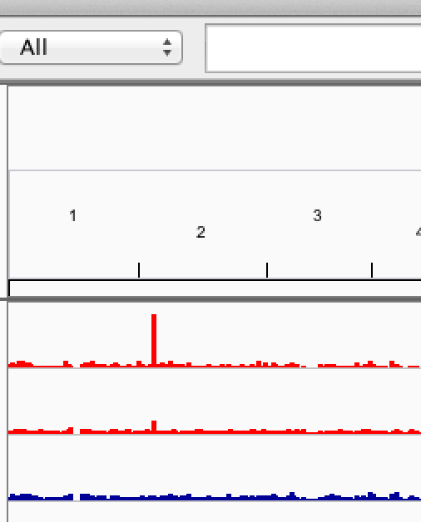

Navigate
 | v | Click on the 1 in the genome ruler to iew chromosome 1

Slide 26
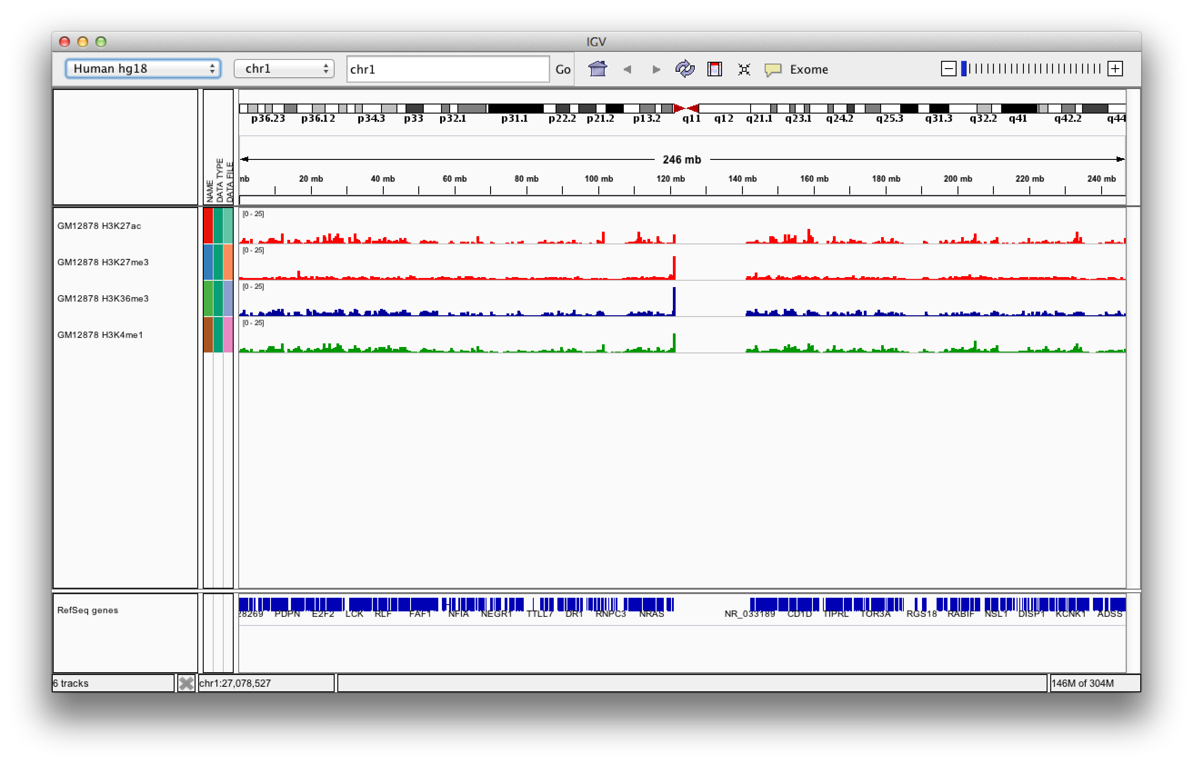
Navigate

Slide 27
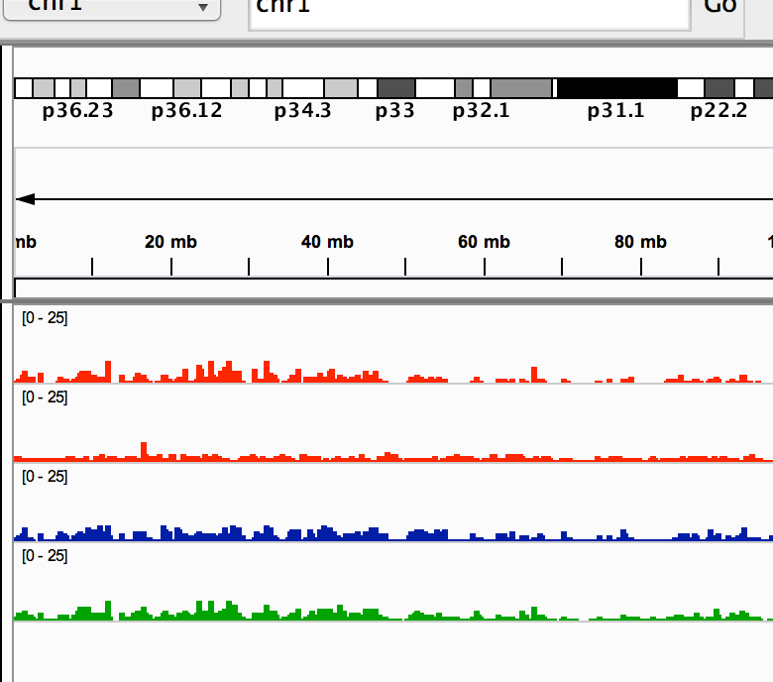



Navigate
Click and drag
from 40 mb to 60 mb on the genomic ruler

Slide 28
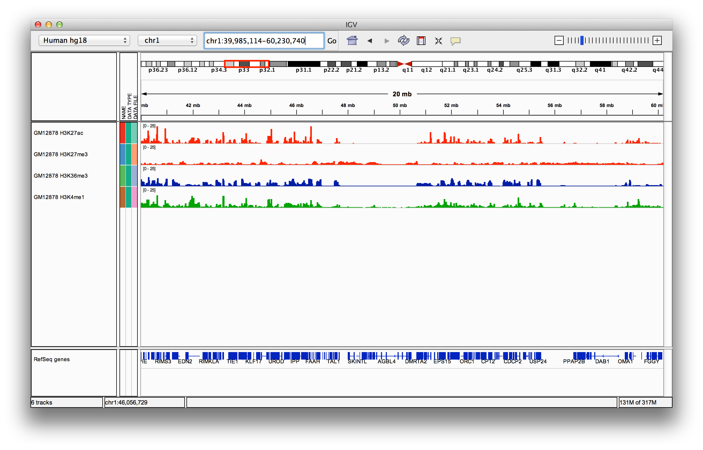
Navigate

Slide 29
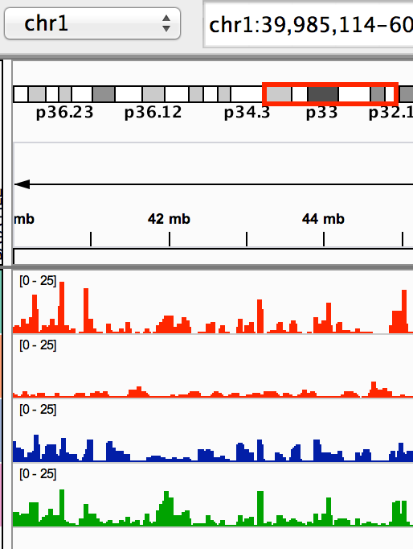


Navigate
Double-click to zoom in for closer view of peak

Slide 30
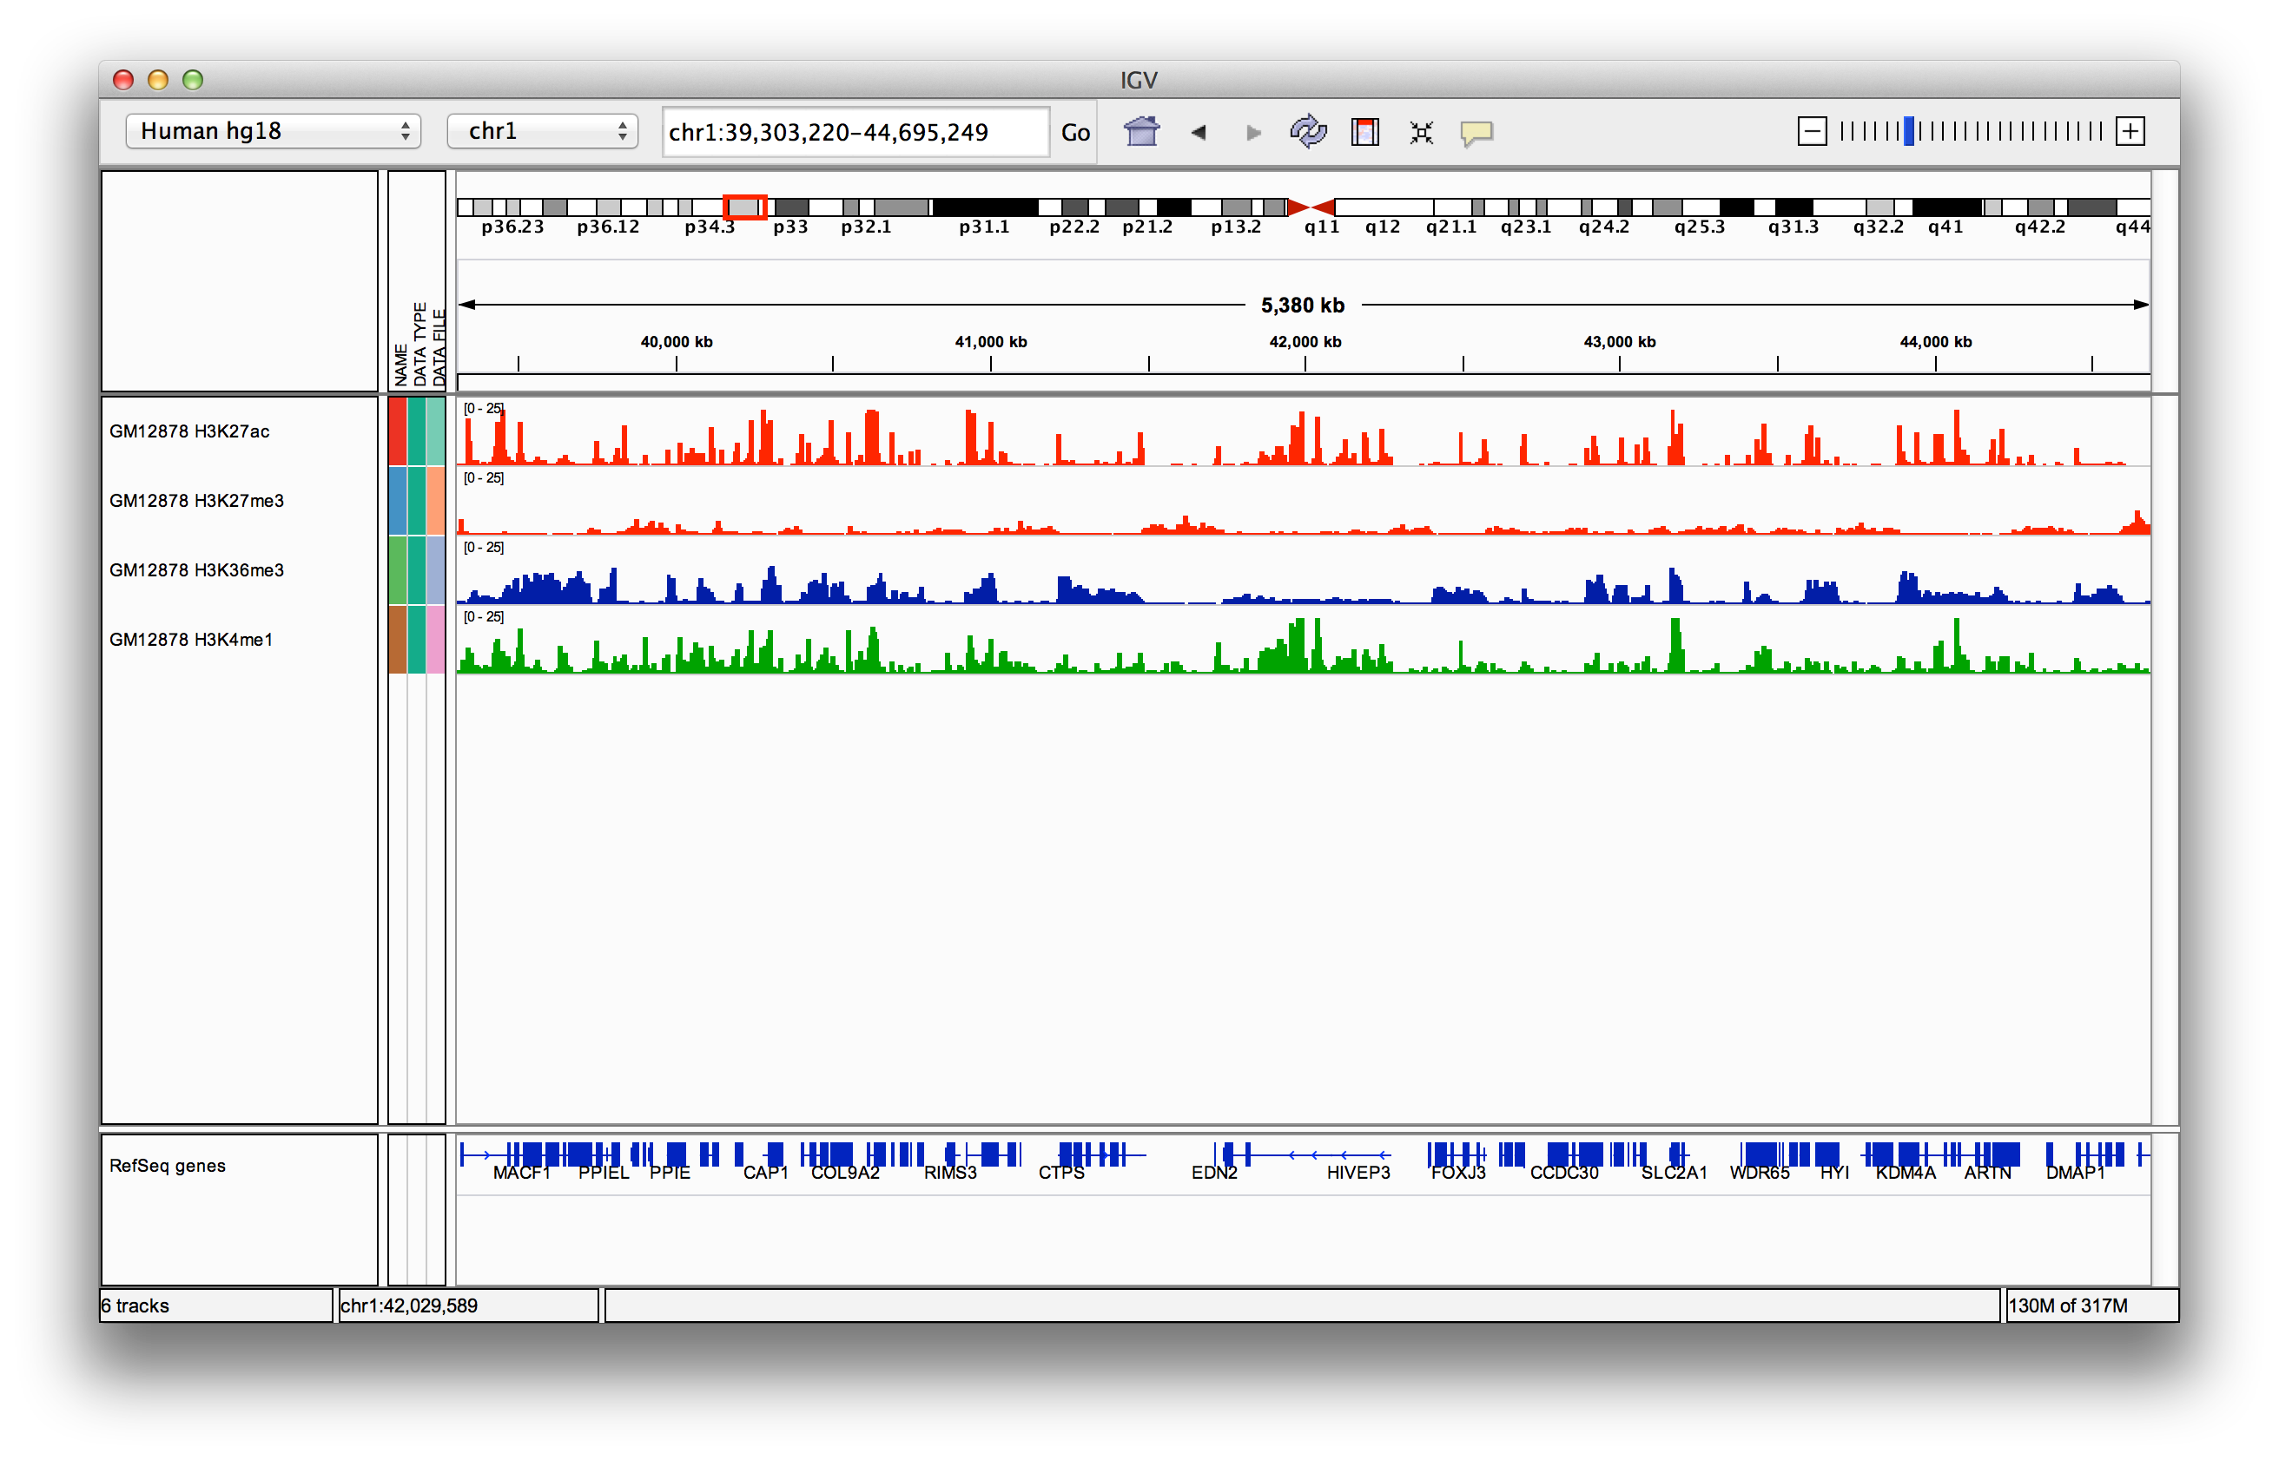
Navigate

Slide 31





Navigate
Click anywhere in the data panel and drag tracks left and right

Slide 32
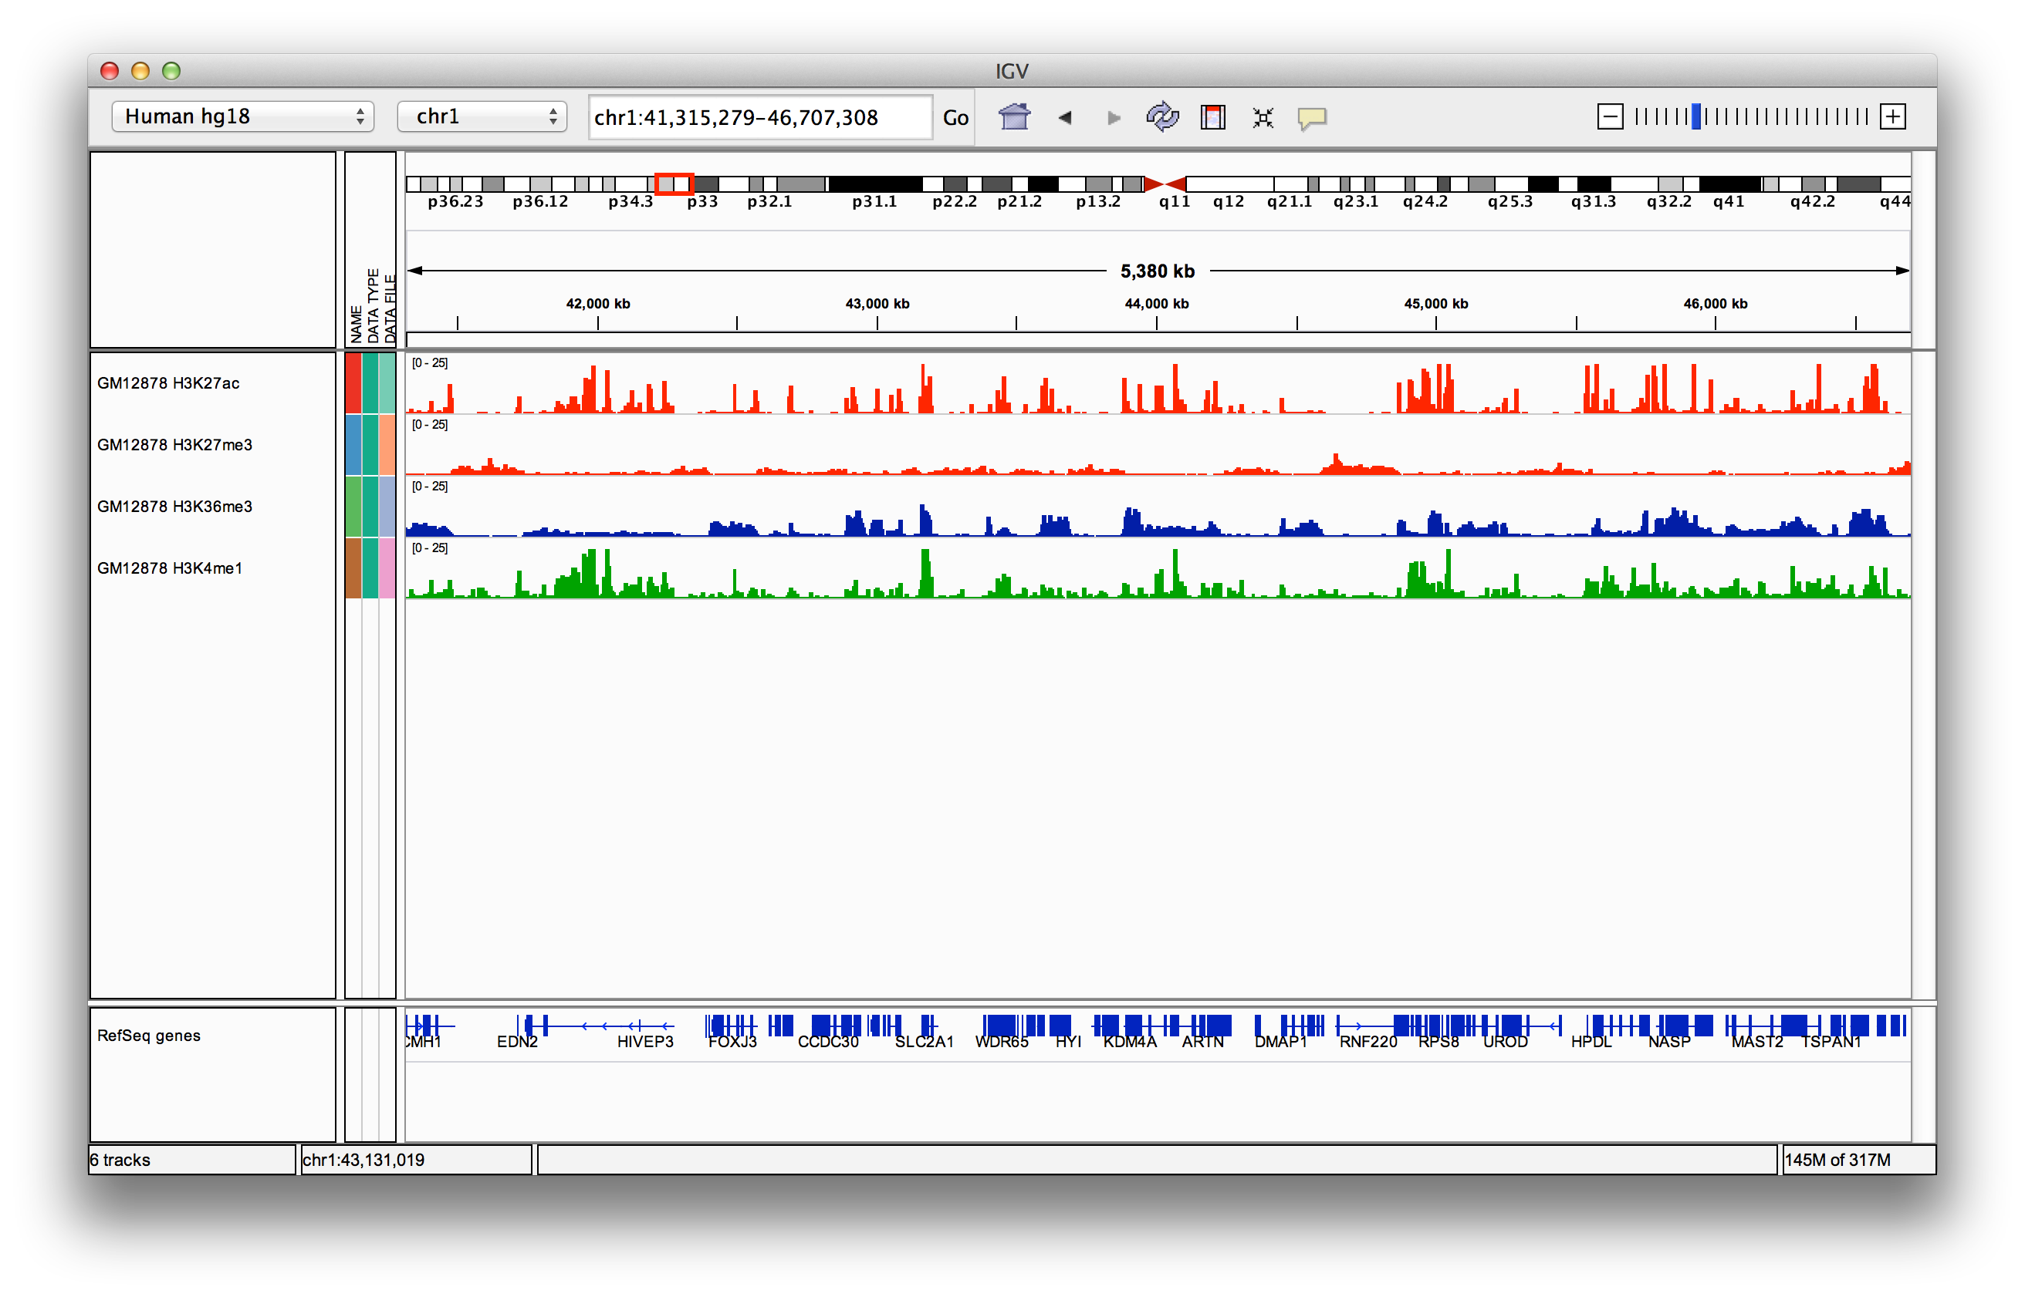
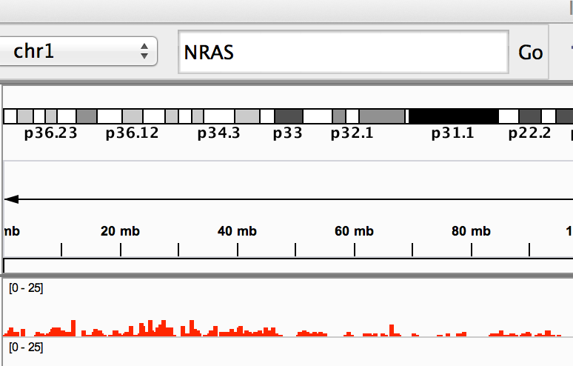


Navigate
 | Type gene name annotation into th and click Go | or other RefSeq e Search Box

Slide 33


Navigate
 | Type gene name annotation into th and click Go | or other RefSeq e Search Box

Slide 34
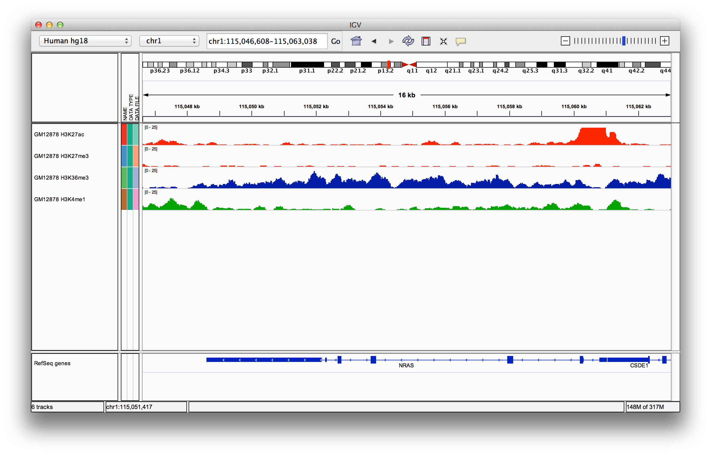

Navigate

Slide 35
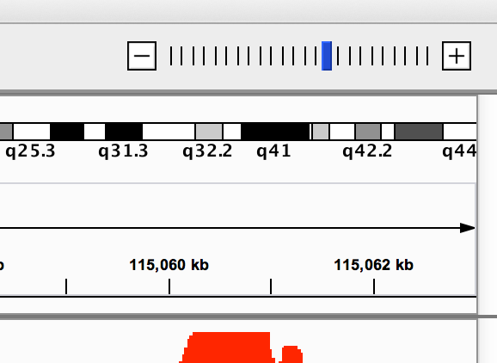


Navigate
Click on the last tick on the “railroad track” to zoom in to maximum resolution

Slide 36
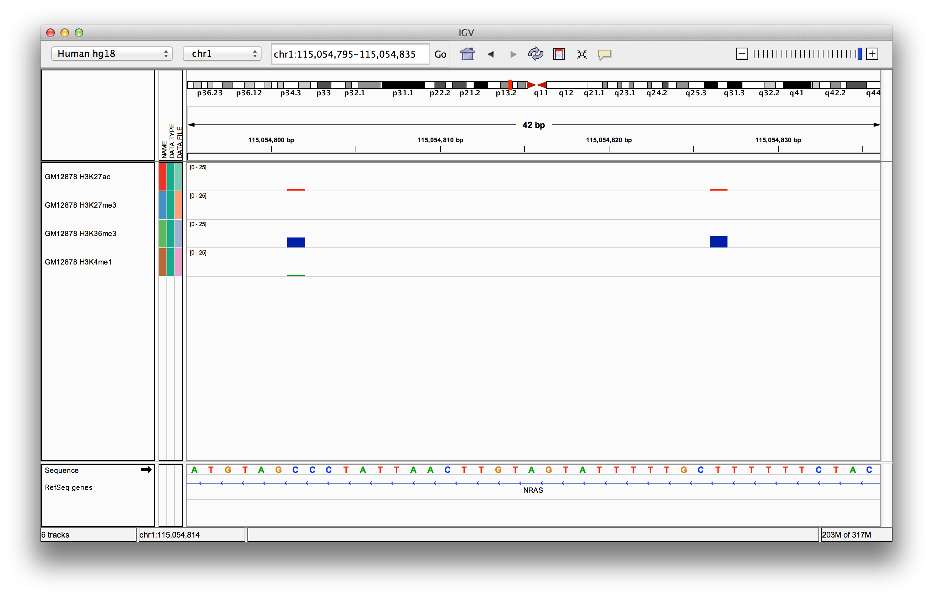

Navigate
Maximum zoom. We’ve moved from whole genome to base pair resolution
Reference sequence

Slide 37

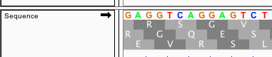
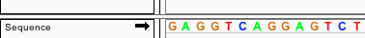

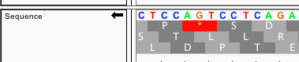
Reference sequence
Click anywhere on the sequence to see a 3 frame translation.
By default the sequence for the forward strand is shown.
Click the arrow on the left to reverse the strand.

Slide 38









Genome annotation track
UCSC style gene representation 5’ UTR Intron Exons _{3’ UTR}
Zoomed in views
Zoomed out views

Slide 39

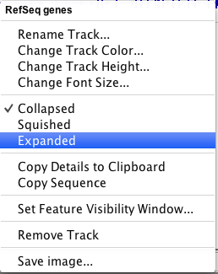
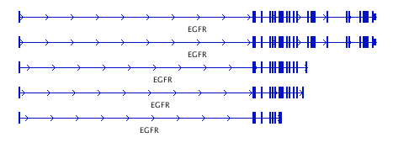
Annotation display mode
Features are drawn in a single row, by default
Expand the track using the popup menu

Slide 40
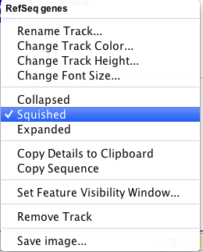
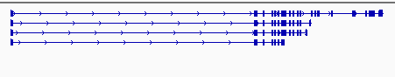
Annotation display mode
3. For a compact view of all variants use “Squished”

Slide 41
Viewing multiple regions

Slide 42
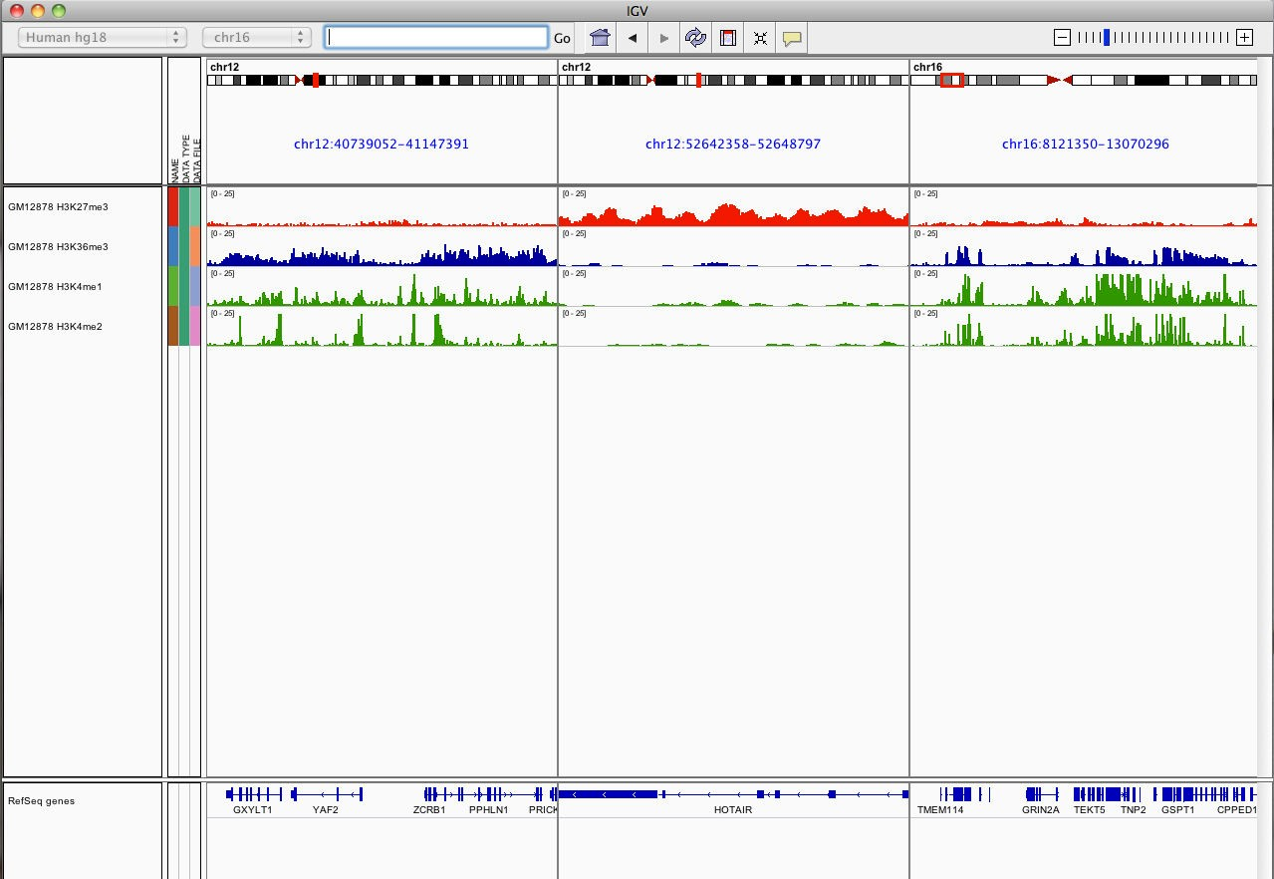
Viewing multiple regions

Slide 43
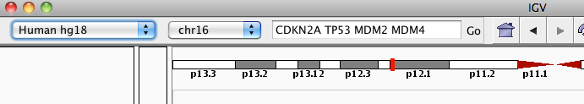

Viewing multiple regions
Search box
Enter multiple loci or features in the search box
Regions > Gene Lists…
Select from a number of pre-defined gene lists, or Create your own persistent list

Slide 44
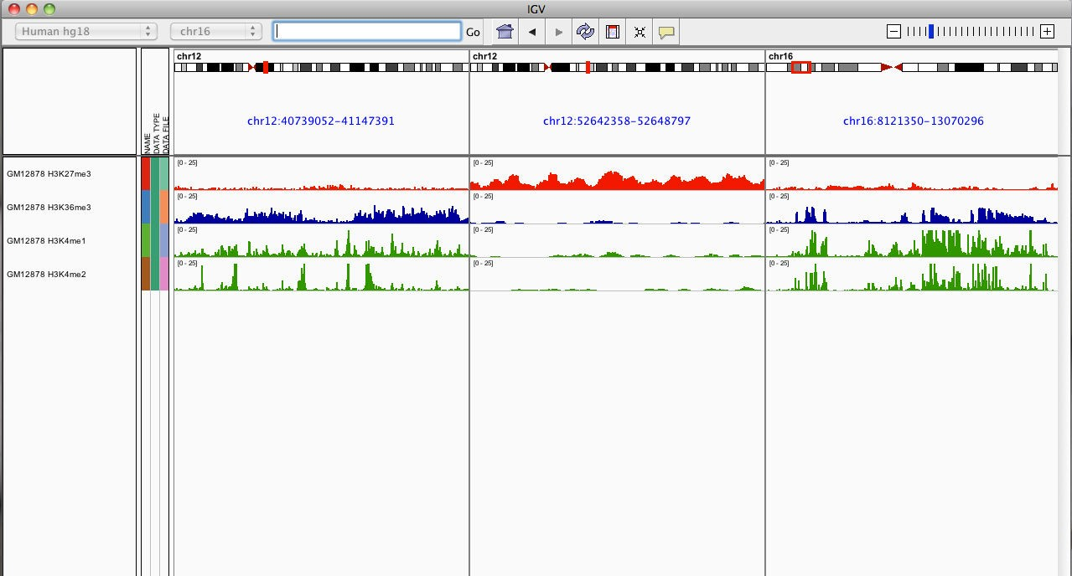

Viewing multiple regions
To go back to the standard, single-region view:
double-click on a region label – or –
right-click and select “Switch to standard view”

Slide 45
Viewing NGS Data

Slide 46
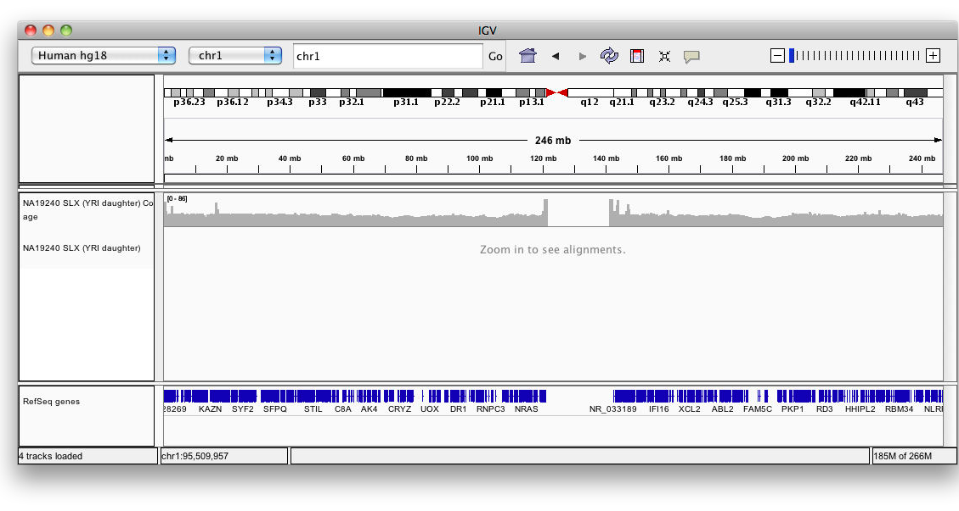
Viewing alignments
Whole chromosome view

Slide 47
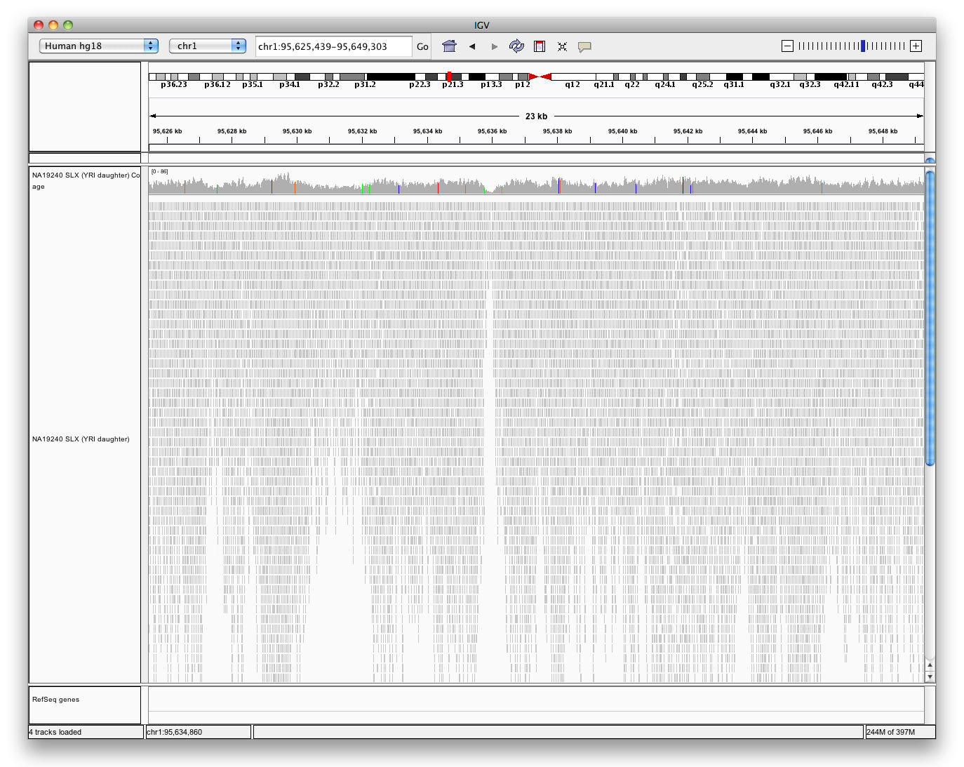
Viewing alignments
Zoom in to view alignments

Slide 48


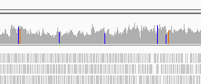
Viewing alignments
Coverage track now has more detail

Slide 49
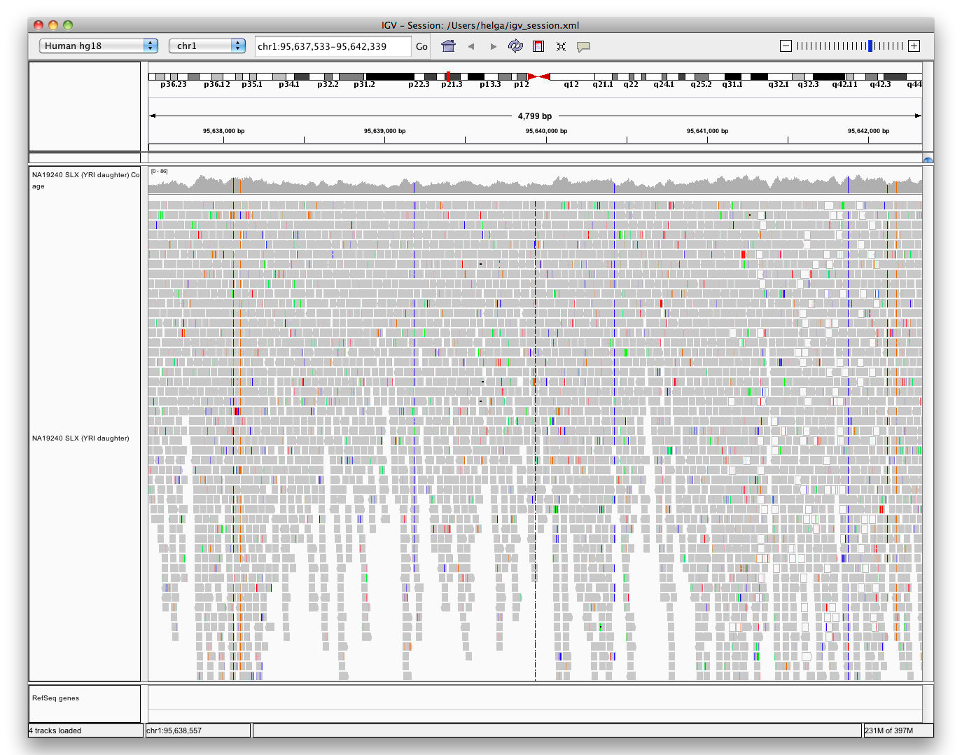
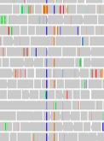
Viewing alignments
Zoom in to see more detail
Bases that do not match the reference sequence are highlighted by color

Slide 50
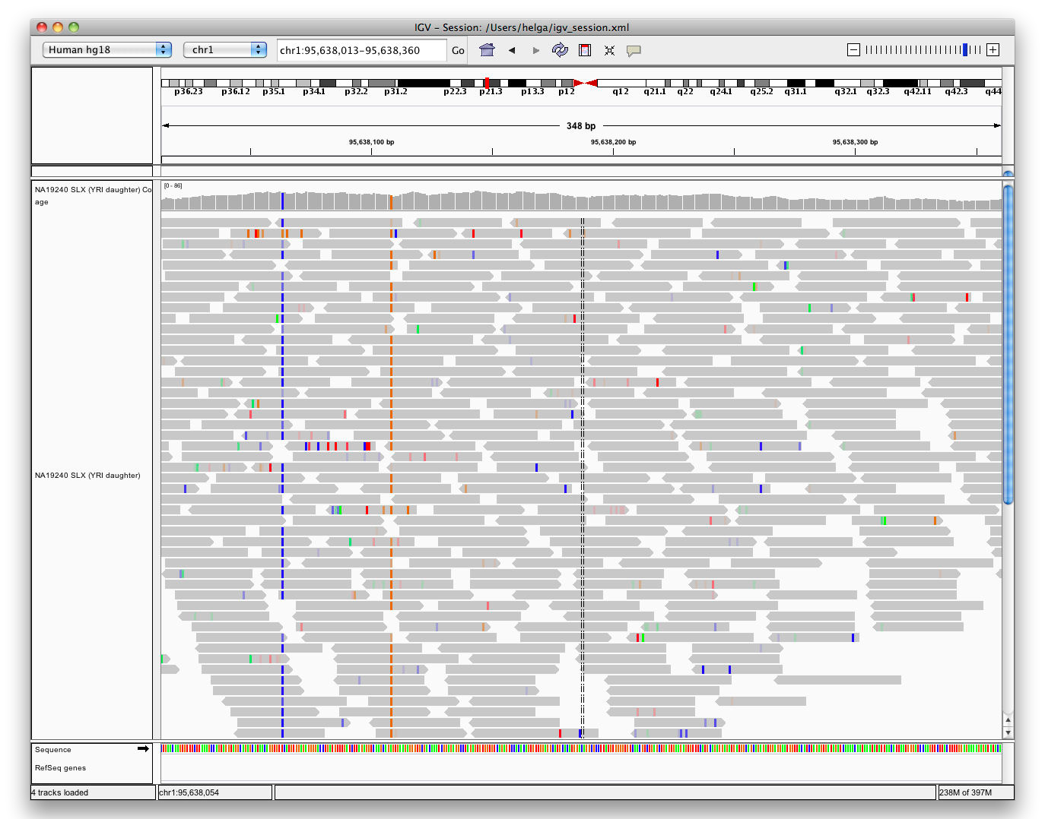
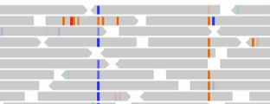
Viewing alignments
Zoom in to see more detail

Slide 51
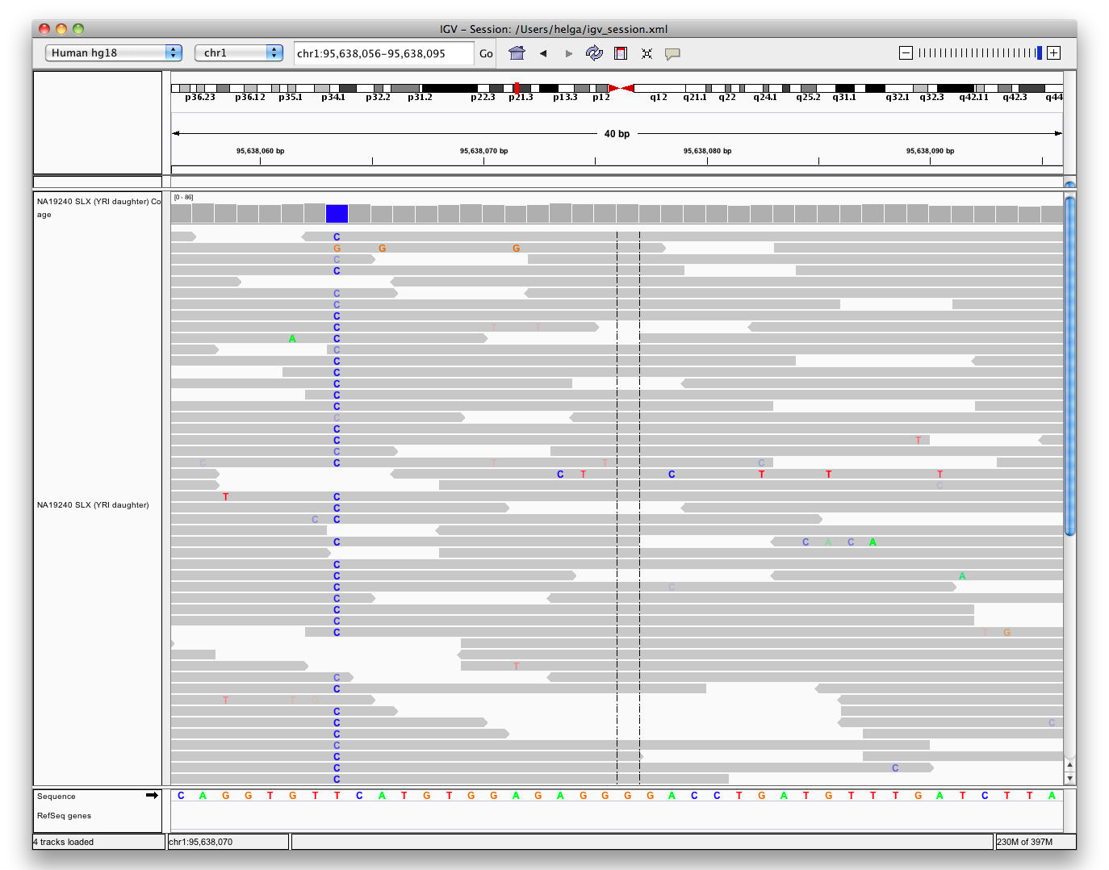

Viewing alignments
Zoom in to see more detail
Low-quality base calls are faint, semi-transparent.

Slide 52

Viewing alignments
How far do you need to zoom in to see the alignments?

Slide 53
Viewing alignments
How far do you need to zoom in to see the alignments?
30 kb | or set a different threshold in preferences
Higher value (larger region) ➔ requires more memory
Low coverage files ➔ ok to use higher value
Very deep coverage files ➔ use lower value

Slide 54

Viewing alignments
Downsampling:
limits displayed read depth
uses less memory

Slide 55
Viewing SNPs
Hands-on exercise
Load alignments from whole genome sequencing
View sites where SNPs were called
Sort and color to highlight patterns

Slide 56


Viewing SNPs
Before we start:
Select File > New Session
to clear IGV window

Slide 57

Viewing SNPs
Select File > Load from Server…

Slide 58




Viewing SNPs
Select File > Load from Server…
Open the
Tutorials menu
Select
SNP Validation

Slide 59



Viewing SNPs
Type “snp1” in the Search Box
and click Go

Slide 60

Viewing SNPs

Slide 61



Viewing SNPs
If necessary, click and drag the window divider for a larger data panel

Slide 62

Viewing SNPs

Slide 63



Viewing SNPs
Click on yellow balloon icon in the toolbar to modify the information popup behavior

Slide 64

Viewing SNPs
Click & drag to position mismatched bases between the center guidelines

Slide 65



Viewing SNPs
Right-click on alignments and select
Sort alignments by > base
On Mac: Right-click = ⌘-click

Slide 66

Viewing SNPs

Slide 67



Viewing SNPs
Mouse over red & blue bar in coverage track. Note allele counts and frequencies.

Slide 68



Viewing SNPs
Type “snp2” in the Search Box
and click Go
Note:
Large % of low quality base calls, and scatter of “C” mismatches

Slide 69
Viewing SNPs
Click & drag to position locus with 5 blue C’s between center guidelines

Slide 70


Viewing SNPs
Right-click on alignments and select
Shade base by quality

Slide 71

Viewing SNPs

Slide 72



Viewing SNPs
Right-click on alignments and select
Sort alignments by > read strand

Slide 73



Viewing SNPs
Right-click on alignments and select
Color alignments by > read strand

Slide 74

Viewing SNPs

Slide 75
Viewing Structural Events

Slide 76
Structural events
Paired reads can yield evidence for genomic “structural events”, such as deletions, translocations, and inversions.
Alignment coloring options help highlight these events based on:
Inferred insert size (template length)
Pair orientation (relative strand of pair)

Slide 77














Paired-end sequencing
DNA or cDNA
Fragment
insert size
Read from each end

Slide 78







Paired-end sequencing
DNA or cDNA
Fragment
insert size
Read from each end
Align to Reference
inferred insert size

Slide 79
Interpreting Insert Size

Slide 80
Interpreting inferred insert size
The “inferred insert size” can be used to detect structural variants, including:
Deletions
Insertions
Inter-chromosomal rearrangements: (Undefined insert size)

Slide 81
Deletion
What is the effect of a deletion on inferred insert size?

Slide 82
Deletion
Reference Genome

Slide 83
Deletion
Reference Genome
Subject

Slide 84


Deletion
Reference Genome
Subject

Slide 85
Deletion
Reference Genome
Subject

Slide 86


Deletion
Reference Genome
Subject

Slide 87


Deletion
Reference Genome
Subject

Slide 88


Deletion
Reference Genome
Subject

Slide 89
Deletion
Reference Genome
inferred insert size
Subject

Slide 90

Deletion
Reference Genome
inferred insert size
Subject
expected insert size

Slide 91
Deletion
Inferred insert size is > expected value
Reference Genome
inferred insert size
Subject
expected insert size

Slide 92

Deletion
Pairs with larger than expected insert size are colored red.

Slide 93


Deletion
Note drop in coverage

Slide 94
Insert size color scheme
Smaller than expected insert size:
Larger than expected insert size:
Pairs on different chromosomes
Each end colored by chromosome of its mate

Slide 95

Rearrangement
CHR 1
CHR 6
TUMOR
NORMAL

Slide 96

Rearrangement
CHR 1
CHR 6
TUMOR
NORMAL
Color indicates mate is on chromosome 6

Slide 97
Interpreting Pair Orientations

Slide 98
Interpreting pair orientations
Orientation of paired reads can reveal structural events, including:
inversions
duplications
translocations
Orientation is defined in terms of
read strand, left vs right, and
read order, first vs second

Slide 99
Inversion
Reference genome

Slide 100
Inversion
Reference genome
A
B

Slide 101


Inversion
Reference Genome
A
B
Subject
B
A

Slide 102

Inversion
Reference Genome
A
B
Subject
B
A

Slide 103

Inversion
Reference Genome
A
B
Subject
B
A

Slide 104

Inversion
Reference Genome
A
B
Subject
B
A

Slide 105


Inversion
Reference Genome
A
B
Subject
B
A

Slide 106

Inversion
Reference Genome
A
B
Subject
B
A

Slide 107

Inversion
Reference Genome
A
B
Subject
B
A

Slide 108
Inversion
Reference Genome
A
B

Slide 109


Inversion
Reference Genome
A
B
Anomaly –
Expected pair orientation is inward facing ( )

Slide 110
Inversion
Reference Genome
A
B
“Left” side pair

Slide 111
Inversion
Reference Genome
A
B
“Right” side pair

Slide 112

Color by pair orientation

Slide 113

Inversion

Slide 114


Inversion
Note drop in coverage at breakpoints

Slide 115














Slide 116
RNA-Seq
Hands-on exercise
Examine tissue-specific alternative splicing.
Data: Illumina BodyMap 2.0
http://www.illumina.com/science/data_library.ilmn

Slide 117
Before we start:
Select File > New Session
to clear IGV window

Slide 118
RNA-Seq Setup
Step 1: Tune settings for RNA.

Slide 119


RNA-seq alignments
Select View > Preferences…

Slide 120


RNA-seq alignments
Click Alignments tab

Slide 121


RNA-seq alignments
Select Show junction track

Slide 122

RNA-seq alignments
Click OK to save changes

Slide 123


RNA-seq alignments
Select Human hg19
from genome menu

Slide 124


RNA-seq alignments
Select:
File > Load from Server…

Slide 125





RNA-seq alignments
Open the
Tutorials menu
Select
RNA-Seq (Body Map)

Slide 126

RNA-seq alignments

Slide 127


RNA-seq alignments
Type SLC25A3

Slide 128

RNA-seq alignments
Click Go

Slide 129

RNA-seq alignments

Slide 130
RNA-seq alignments
If reads are still blue & red from the settings for the last exercise, then right-click and select
Color alignments by > no color

Slide 131
RNA-seq alignments
Heart
Liver

Slide 132

RNA-seq alignments
Coverage

Slide 133
RNA-seq alignments
Junction Coverage

Slide 134

RNA-seq alignments
Alignments

Slide 135

RNA-seq alignments
Right-click over RefSeq Genes track

Slide 136


RNA-seq alignments
Select Squished

Slide 137


RNA-seq alignments
Isoforms now displayed

Slide 138



RNA-seq alignments
Click & drag on ruler to zoom in on first 2 exons

Slide 139

RNA-seq alignments

Slide 140
RNA-seq alignments
Evidence of alternative splicing

Slide 141
Sashimi plot
Viewing RNA splicing with Sashimi Plots
Reference: Katz Y, Wang ET, Silterra J, Schwartz S, Wong B, Mesirov JP, Airoldi EM, Burge, CB. Sashimi plots: Quantitative visualization of RNA sequencing read alignments. arXiv:1306.3466 [q- bio.GN], 2013

Slide 142

RNA-seq alignments
Right-click over alignments

Slide 143


RNA-seq alignments
Select
Sashimi Plot

Slide 144


RNA-seq alignments
 | Se Re | lect fSeq Genes

Slide 145


RNA-seq alignments
 | Sel He | ect both art and Liver

Slide 146

RNA-seq alignments

Slide 147
RNA-seq alignments
A little busy. Let’s filter out low-count events

Slide 148
RNA-seq alignments
Right-click anywhere over plot

Slide 149



RNA-seq alignments
Select

Slide 150


RNA-seq alignments
Enter 20

Slide 151

RNA-seq alignments

Slide 152
igvtools

Slide 153
igvtools
A set of utilities for preparing files for efficient display.
toTDF | Converts sorted data file to a binary tiled data file (TDF). Supported file formats: .wig, .cn, .snp, .igv, .gct
count | Computes average alignment or feature density over a specified window size across the genome. Supported file formats: .sam, .bam, .aligned, .sorted.txt, .bed
sort | Sorts file by genomic start position. Supported file formats: .cn, .igv, .sam, .aligned, .bed.
index | Creates an index file for alignment or feature file. Supported file formats: .sam, .aligned, .sorted.txt, .bed

Slide 154

igvtools
Can be launched from the IGV user interface File > Run igvtools…
Or run from the command line

Slide 155
igvtools toTDF
The toTDF utility converts large ASCII data files into tiled data format (.tdf) files.
TDF files have the following advantages:
Data is indexed for efficient retrieval.
Data is preprocessed for zoomed out views.
TDF files are web friendly – large data files can be shared over the web. Only small slices of the file are actually transferred as needed.

Slide 156


igvtools count
The count command is used to transform alignment files to read density TDF files, e.g. for ChIP-Seq, RNA-Seq, and similar alignment counting experiments.
igvtools
Alignments
Read Density
Alignments in bam/sam,
.aligned, or bed format
TDF format, indexed and optimized for fast retrieval at multiple resolution scales

Slide 157
igvtools sort
Sorts IGV-supported genomic formats by start position.
The index command requires sorted files.
Example:
igvtools sort -m 1000000 –t ~/myTmpDir inputFile.sam outputFile.sorted.sam
Uses combination of memory and disk to handle large files.
-m = maximum # of lines to hold in memory. When this number is exceeded a temporary file is created.
-t = directory used to create temporary files during sorting.

Slide 158
igvtools index
Creates an index file for viewing large files in bed, gff, or vcf formats. An index is optional for bed or gff files, but required for vcf files.
An alternative indexing tool is “tabix”. Tabix both compresses and indexes genomic files. IGV can read either type of index (igvtools or tabix).
Example:
igvtools index myFeatures.bed
The index file must remain in the same directory as the input file

Slide 159
Computing coverage: igvtools
Hands-on exercise
Compute alignment coverage from a BAM file using igvtools count command.
Data source
Illumina BodyMap

Slide 160
Download data files required for this exercise from: ftp://ftp.broadinstitute.org/pub/igv/CSH_2013/files.zip
Files included in the zip: heart.bodyMap.bam heart.bodyMap.bam.bai sacCer3.fa (used in next exercise)

Slide 161

Computing coverage: igvtools
Select Tools > Run igvtools…

Slide 162

Computing coverage: igvtools
Select Count command

Slide 163

Computing coverage: igvtools
Select input file heart.bodyMap.bam Output filename will be filled in automatically.

Slide 164

Computing coverage: igvtools
Click Run

Slide 165


Computing coverage: igvtools
Wait for “Done” message (should be fast).

Slide 166

Computing coverage: igvtools
Click Close

Slide 167


Computing coverage: igvtools
Select
File > Load from File…

Slide 168


Computing coverage: igvtools
Select heartBodyMap.bam.tdf
(output from igvtools)

Slide 169


Computing coverage: igvtools
See coverage blip at whole-genome view. The BAM file only has data around a single gene on chr 12.

Slide 170


Computing coverage: igvtools
Enter SLC25A3 in the search box and click Go

Slide 171

Computing coverage: igvtools

Slide 172
More about reference genomes
IGV doesn’t host the genome you need?
Use any genome you want, if you have the sequence in FASTA format.
Optionally, package genome annotations with the sequence.

Slide 173
Loading a genome
Hands-on exercise

Slide 174

Loading a genome
Select
Genomes > Load Genome from File…

Slide 175

Loading a genome
Select sacCer3.fa
(FASTA file for S. cerevisiae)

Slide 176

Loading a genome

Slide 177


Loading a genome
Click on a chromosome name or use the pulldown menu to jump to the chromosome view.

Slide 178

Loading a genome

Slide 179

Loading a genome
Click the rightmost “tick” to jump to base pair resolution

Slide 180


Loading a genome
Confirm that you see sequence

Slide 181
Acknowledgments
IGV Team
Jim Robinson, Jacob Silterra, Helga Thorvaldsdóttir, Jill Mesirov (PI)
Funding
IGV development has been made possible with funding from:
National Cancer Institute (NCI) http://cancer.gov/
Starr Cancer Consortium http://www.starrcancer.org/
National Institute of General Medical Sciences (NIGMS) of the National Institutes of Health http://www.nigms.nih.gov/
IGV participates in GenomeSpace http://genomespace.org/, which is funded by the the National Human Genome Research Institute (NHGRI) http://www.genome.gov/

Slide 182
For further information and help: http://www.broadinstitute.org/igv http://groups.google.com/group/igv-help
Cite:
Robinson et al.
Integrative Genomics Viewer.
Nature Biotechnology 29, 24–26 (2011).
Thorvaldsdóttir, Robinson, and Mesirov. Integrative Genomics Viewer (IGV): high-performance genomics data visualization and exploration.
Briefings in Bioinformatics (2012).

